Slide 1
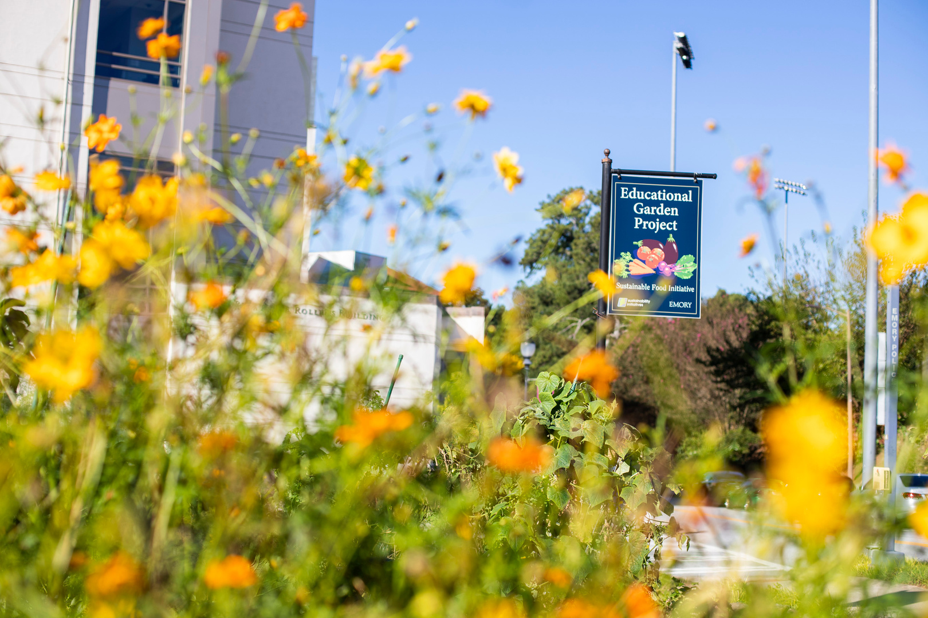



Sustainability Vision Conversation & Input Guide
For Emory’s 2025-2036 Sustainability Vision and Strategic Plan

Slide 2
Emory’s 2025-2036 Sustainability Vision and Strategic Plan
This year, Emory is launching the creation of its third Sustainability Vision and Strategic Plan, which will establish and guide Emory’s ambitions to model transformative practices and sustainable choices at every level.
To ensure that the new plan honors the entire Emory Community, your input is essential! The Office of Sustainability Initiatives and Sustainability Visioning Committee are seeking the community’s input on your sustainability priorities. This guide is a tool to help you share your feedback and input individually or in a group of colleagues or friends.
Move through this guide to learn more about the upcoming Sustainability Vision, to discuss or think about sustainability at Emory, and to share your input! A Facilitator‘s Guide is available to accompany this presentation.

Slide 3
Review the background resources individually or as a group
How to Participate
01.
Spend time thinking or talking about each topic and filling out the input survey
02.
This Guide is a tool to help the Emory community submit their input on Emory’s upcoming Sustainability Vision. Use this guide on your own or in a small group of colleagues or friends. The guide will help you move through the following steps:
Debrief and submit the input survey
03.

Slide 4
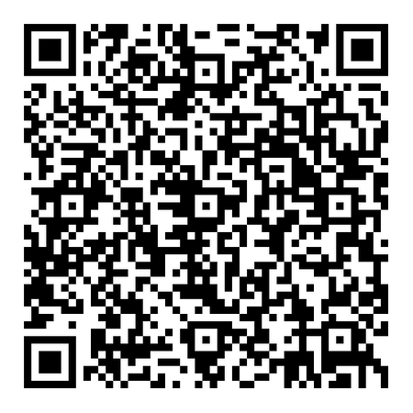
Resources
The following background resources may help you understand the context of sustainability at Emory and the upcoming Sustainability Vision. Take a moment to read the descriptions of each resource. It’s also okay to continue to the discussion and input submission without reviewing the resources. Scan the QR code on the right or follow this link to view the background resources.
Implementation Progress Report
SDGs
Past Vision
The new Sustainability Vision will use the United Nation’s Sustainable Development Goals (SDGs) as a framework. The SDGs are 17 goals that represent the interconnected nature of environmental, social, and economic issues that support the planet, all people, and prosperous economies.
The last Sustainability Vision and Strategic Plan for 2015-2025 has guided Emory through a decade of sustainability action on and around campus.
The OSI team has created an Implementation Progress Report, which provides information on Emory’s progress toward all 91 goals from the prior vision.

Slide 5


Slide 6
UN Sustainable Development Goals: a Blueprint for Peace and Prosperity
In the discussion, your group will spend time discussing what Emory could do to work toward the UN SDGs. The SDGs will be separated into three groups, illustrated in the “wedding cake” infographic on the next slide. As you will see on the following slide, we can understand the SDGs as falling into four groups: SDGs for the planet, SDGs for people, SDGs for prosperity, and SDGs representing the systems of peace and partnership necessary to achieve the other substantive SDGs. As your group moves into the discussion sessions, you will discuss the planet, people, and prosperity SDGs for ~10 minutes each.

Slide 7
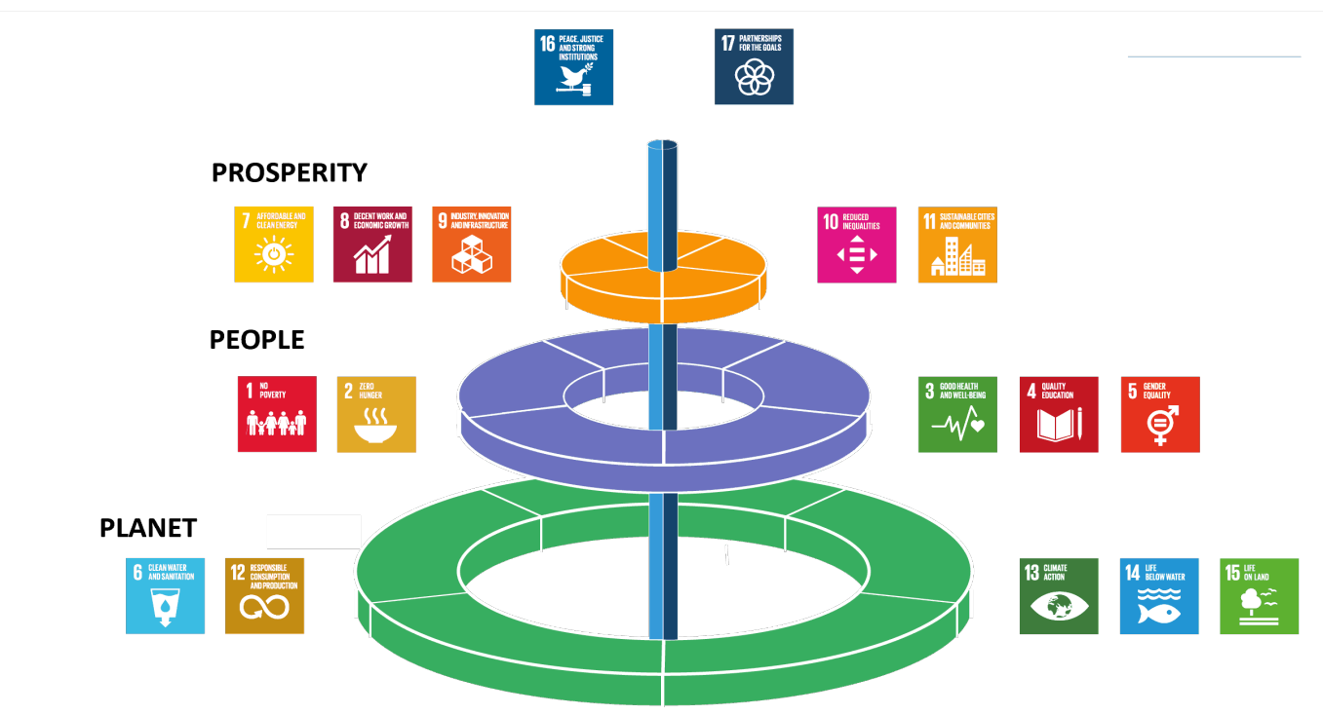















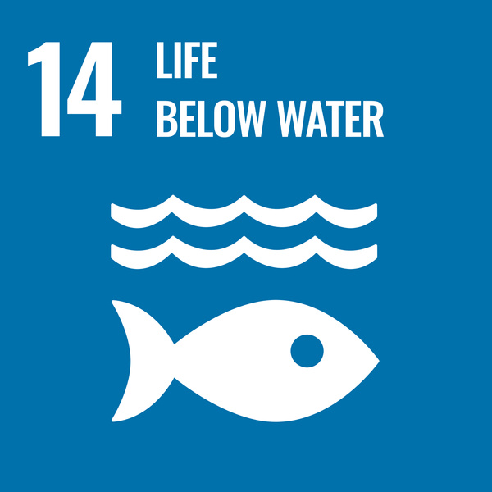

The Wedding Cake
In the infographic, you can see that prosperity is dependent on people, that both prosperity and people are dependent on a healthy planet, and that peace and partnership support the entire structure.

Slide 8
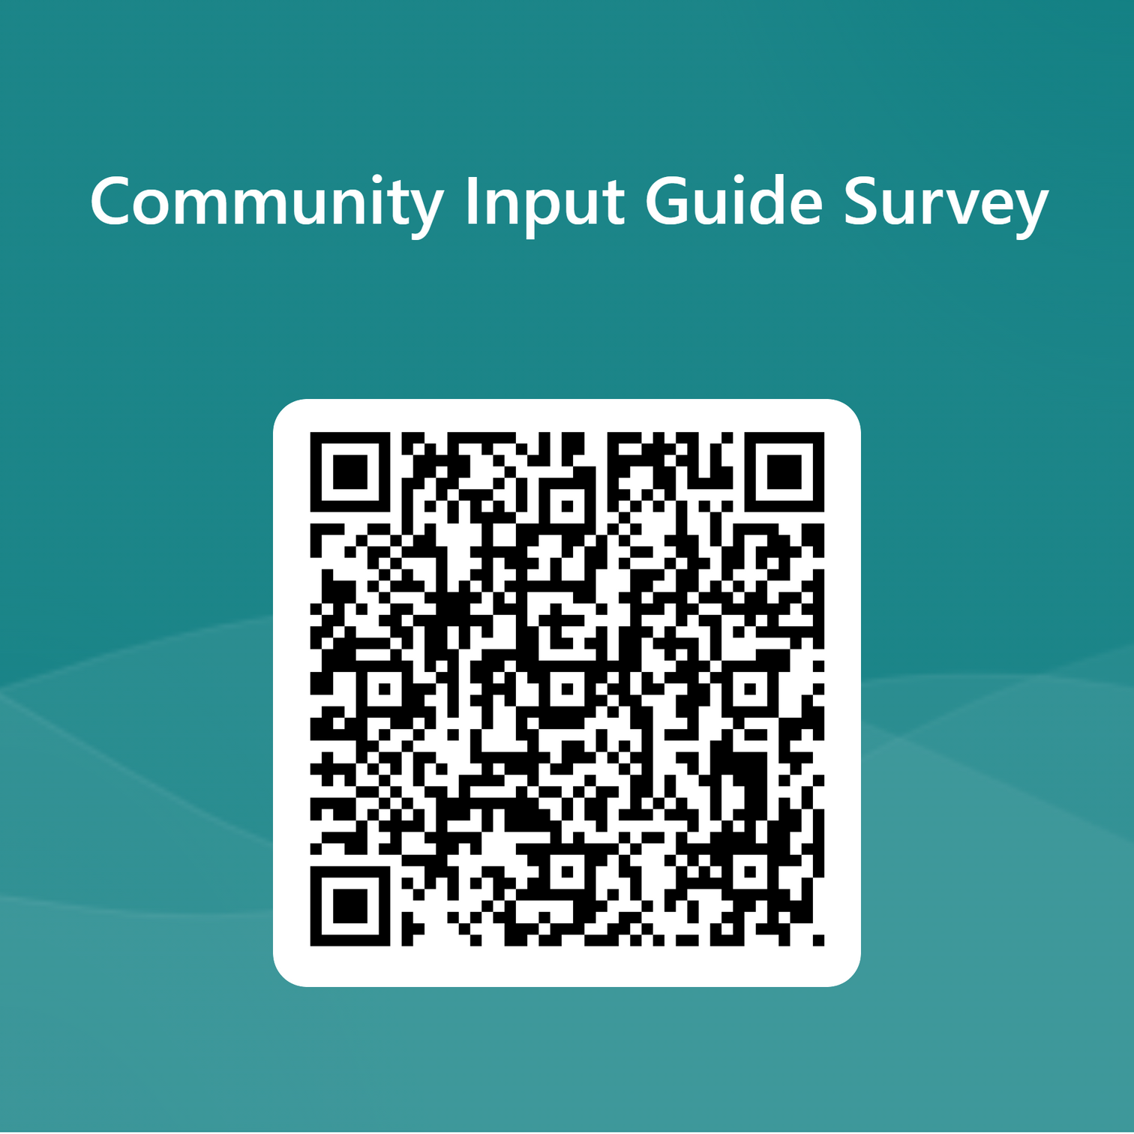
The Survey
As you discuss the SDGs for the planet, people, and prosperity, register your input and answer the questions in the Sustainability Vision Community Input Survey. Scan the QR Code on the right or follow this link to view the survey.

Slide 9
Discussion 1: SDGs for the Planet
  Discussion Question: What could “we” do to move us closer to achieving the UN SDGs for the planet (listed below)?
  Discuss for ~10 minutes. Choose any SDG that appeals to you/the group and let the conversation flow from one SDG to the others. It is okay if you don’t discuss all the SDGs for the planet.
  Scan the QR Code below and spent about ~5 minutes on the first section of the input survey
Scan the QR Code below or follow this link to register your input by taking the Sustainability Vision Community Input Survey.

Slide 10

Discussion 2: SDGs for People
  Discussion Question: What could “we” do to move us closer to achieving the UN SDGs for people (listed below)?
  Discuss for ~10 minutes. Choose any SDG that appeals to you/the group and let the conversation flow from one SDG to the others. It is okay if you don’t discuss all SDGs for people.
  Continue to the next section of the survey and spent about ~5 minutes on the second section

Slide 11
Discussion 3: SDGs for Prosperity
  Discussion Question: What could “we” do to move us closer to achieving the UN SDGs for the prosperity (listed below)?
  Discuss for ~10 minutes. Choose any SDG that appeals to you/the group and let the conversation flow from one SDG to the others. It is okay if you don’t discuss all SDGs for prosperity.
  Continue to the next section of the survey and spend about ~5 minutes on the third section.

Slide 12
Debrief and Complete the Survey
  Consider what you have thought and spoken about as you have worked through this guide.
  Is there anything you would like to add as you reflect?
  Take a few minutes to complete and submit your survey.

Slide 13
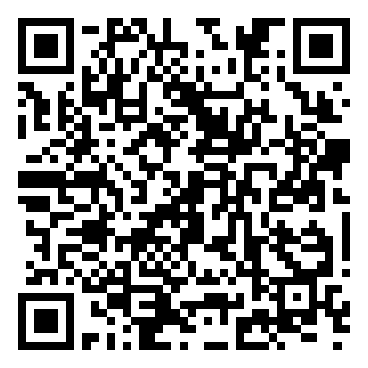



Thank You for Participating!
Sign up for our newsletter
Become a Zero Waste Ambassador
Take the Sustainability Pledge
Thank you for submitting your input for Emory’s 2025-2036 Sustainability Vision and Strategic Plan! We hope that you continue your involvement in sustainability at Emory by checking out the links or scanning the QR code on the right!
Visit our website to learn more!

